Slide 1
Fall robotics 2019
Accomplishments and goals

Slide 2
Where we started
The fall semester of robotics started with nothing but a single member, who is now the chair of the Robotics club.
With no parts, plans or certainty of where the club would go, our first goal was to establish parts and a future for the Robotics Club.

Slide 3
First set of goals
In order to prevent the Robotics club from being completely wiped out of resources again, it was decided that we would use as few loaned parts as possible, and focus on donating or ordering assets for the club to own, rather than for individuals.
We needed a design that could be used by future generations of robotics teams rather than a robot designed for one purpose that would be shelved after its use.
We needed to train as many people as we could so they could carry the torch once the senior members graduated.

Slide 4
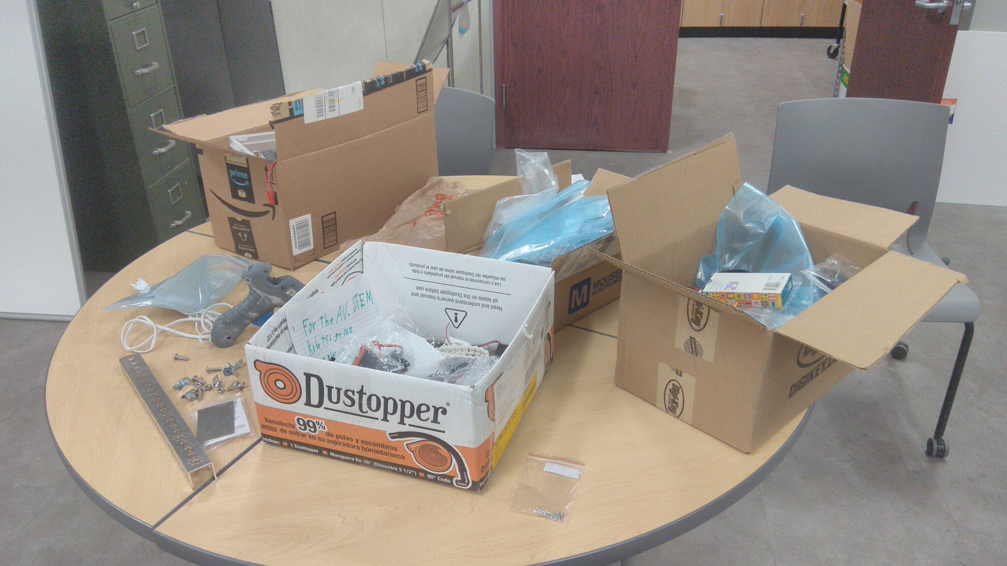
First steps forward
Thanks to the efforts of Dr. Compton, we were able to use a small robot that could be assembled, programmed, and capable of autonomous movement while we waited for the ordered parts to arrive.
We made sure to separate parts into appropriate boxes so loaned parts could be identified from parts owned by the club

Slide 5
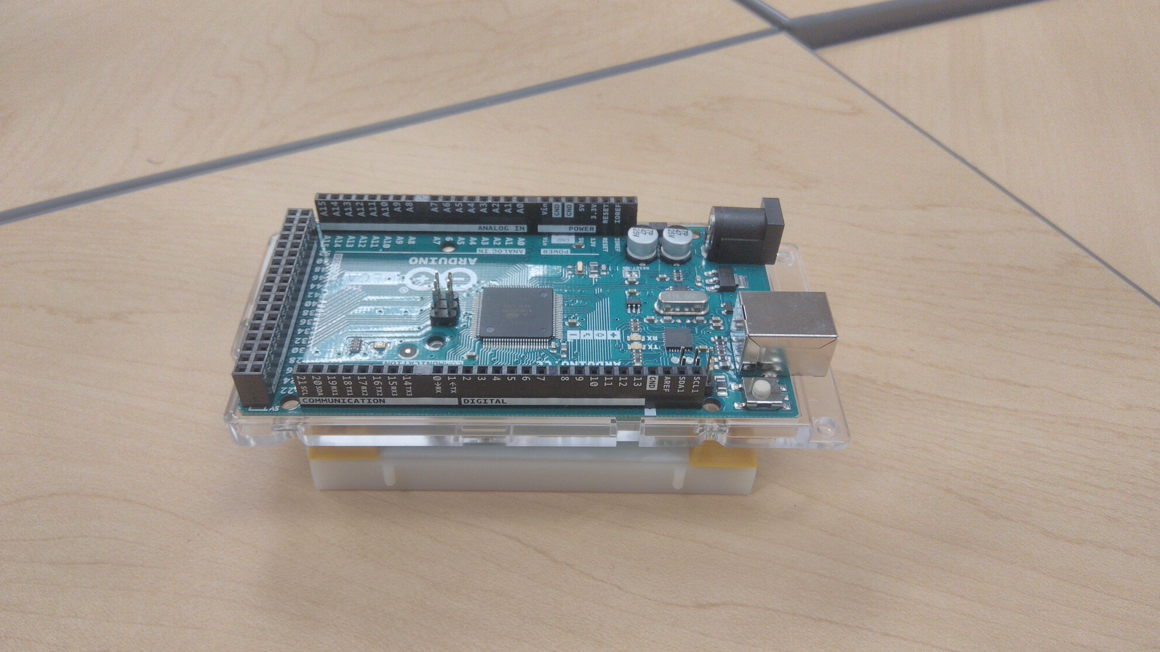
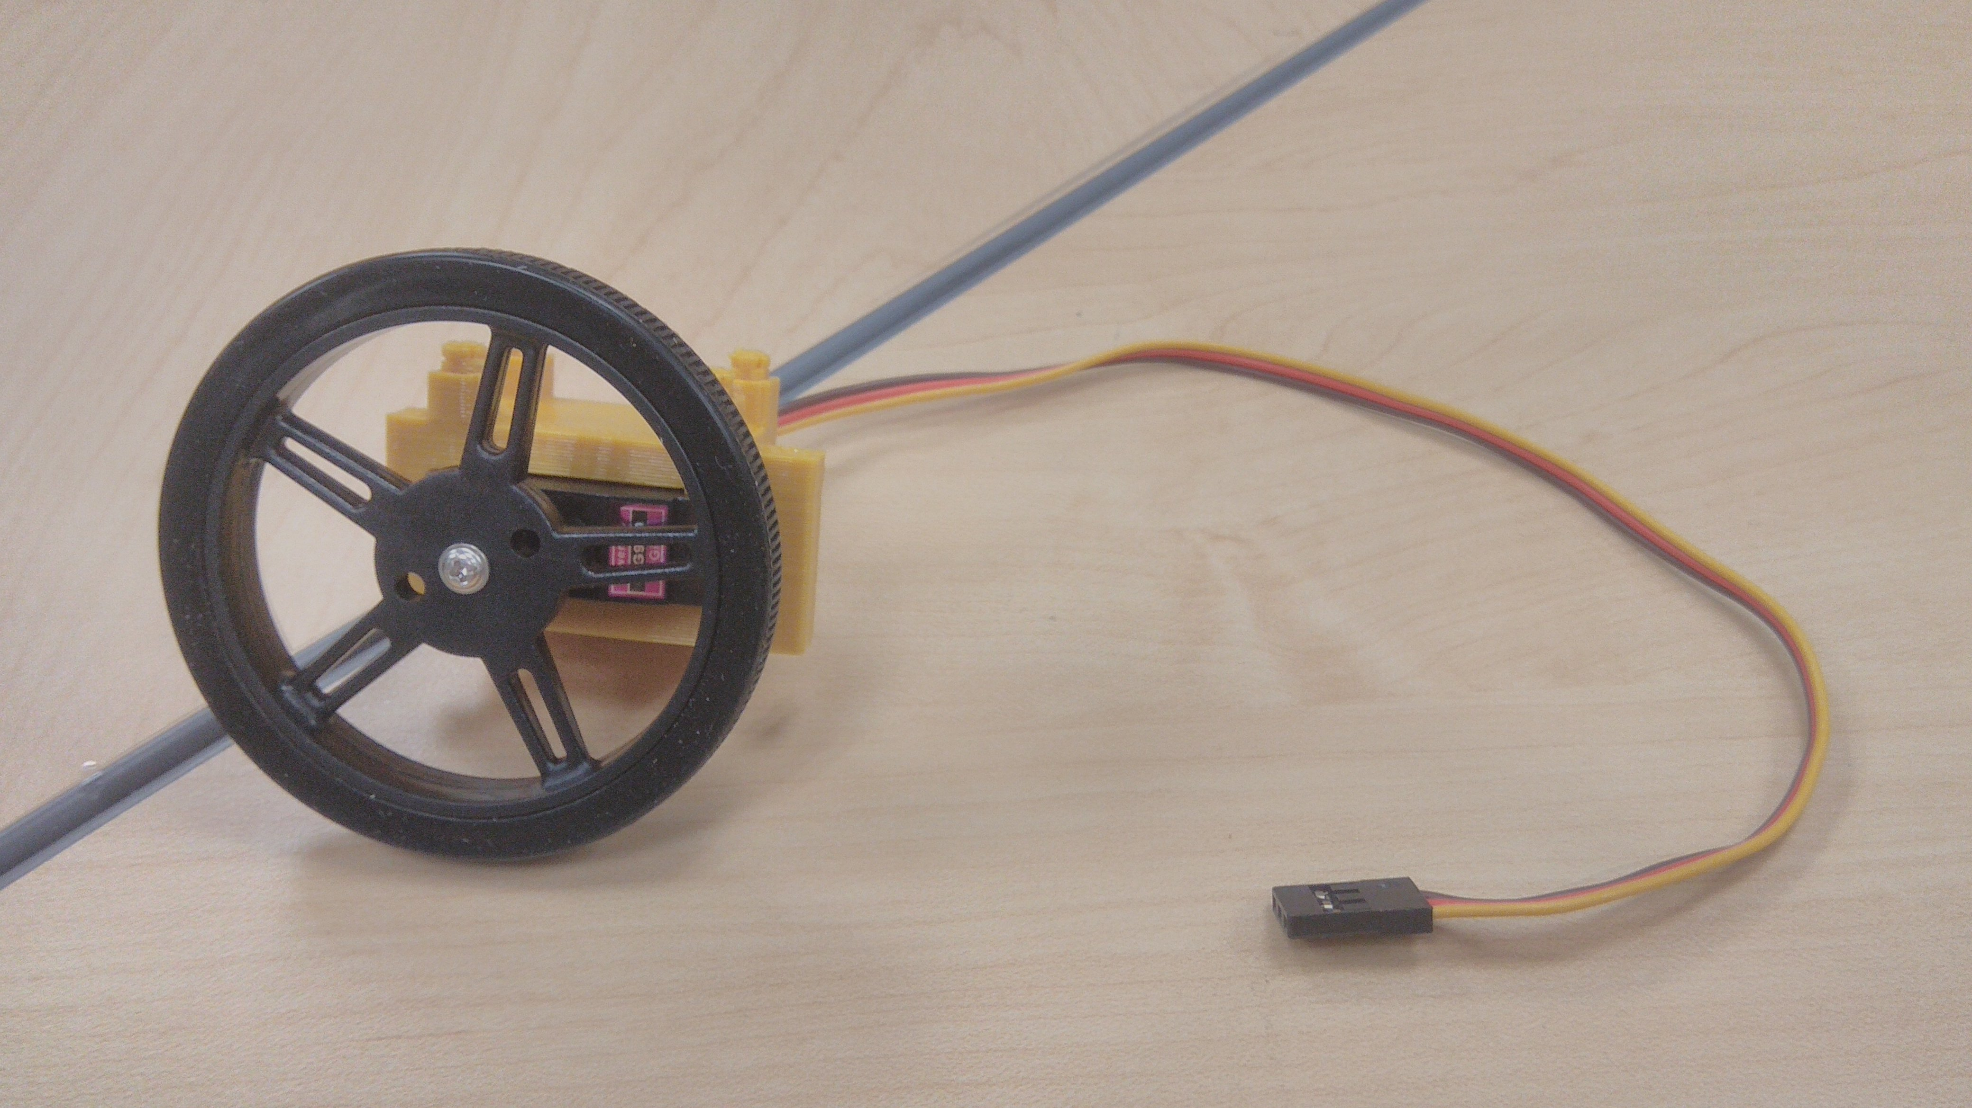
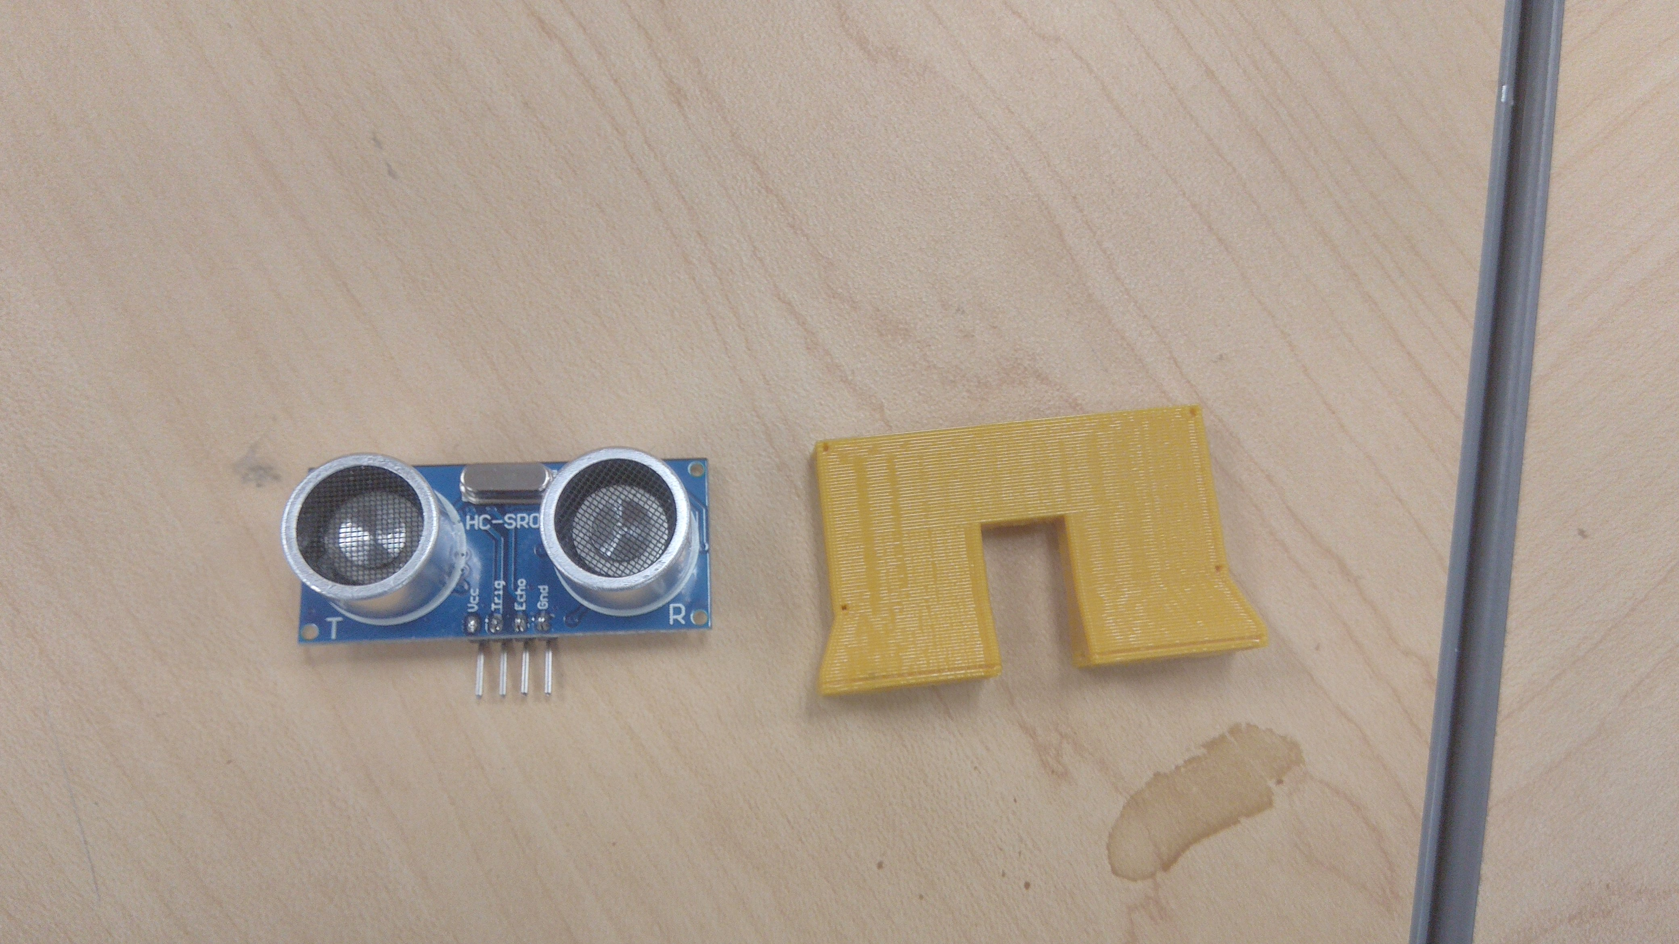
Design and programming
Nicholas Brunet was kind enough to provide an Arduino in order for us to program and troubleshoot the parts we were loaned. Thanks to his efforts and the patience of the programming team, the sonic sensors were able to detect objects close to it, and stop the servo motors from moving, which would prevent the robot from crashing into an object.

Slide 6
What we learned
As time went on, we were assisted with building and machine training by Denilson and Jamie for the 3D printer, as well as loaned extra parts for the sake of learning programming.
Ordering was refined to include what we needed as well as to order promptly but accurately.
Programming and files were to be shared with all members via GitHub so they were not lost if someone was unavailable.
Time management and individual contribution are vital to any team.

Slide 7
How we improved
Members now have been given a crash-course to programming as well as a number of them trained for the 3D printer for future generations
Building and designing has been adjusted for the equipment we have available.
We are now more prompt and careful with our ordering, as well as understanding of the importance of donating even the smallest parts
We now have a plethora of parts needed for us to build for intersession and spring.

Slide 8
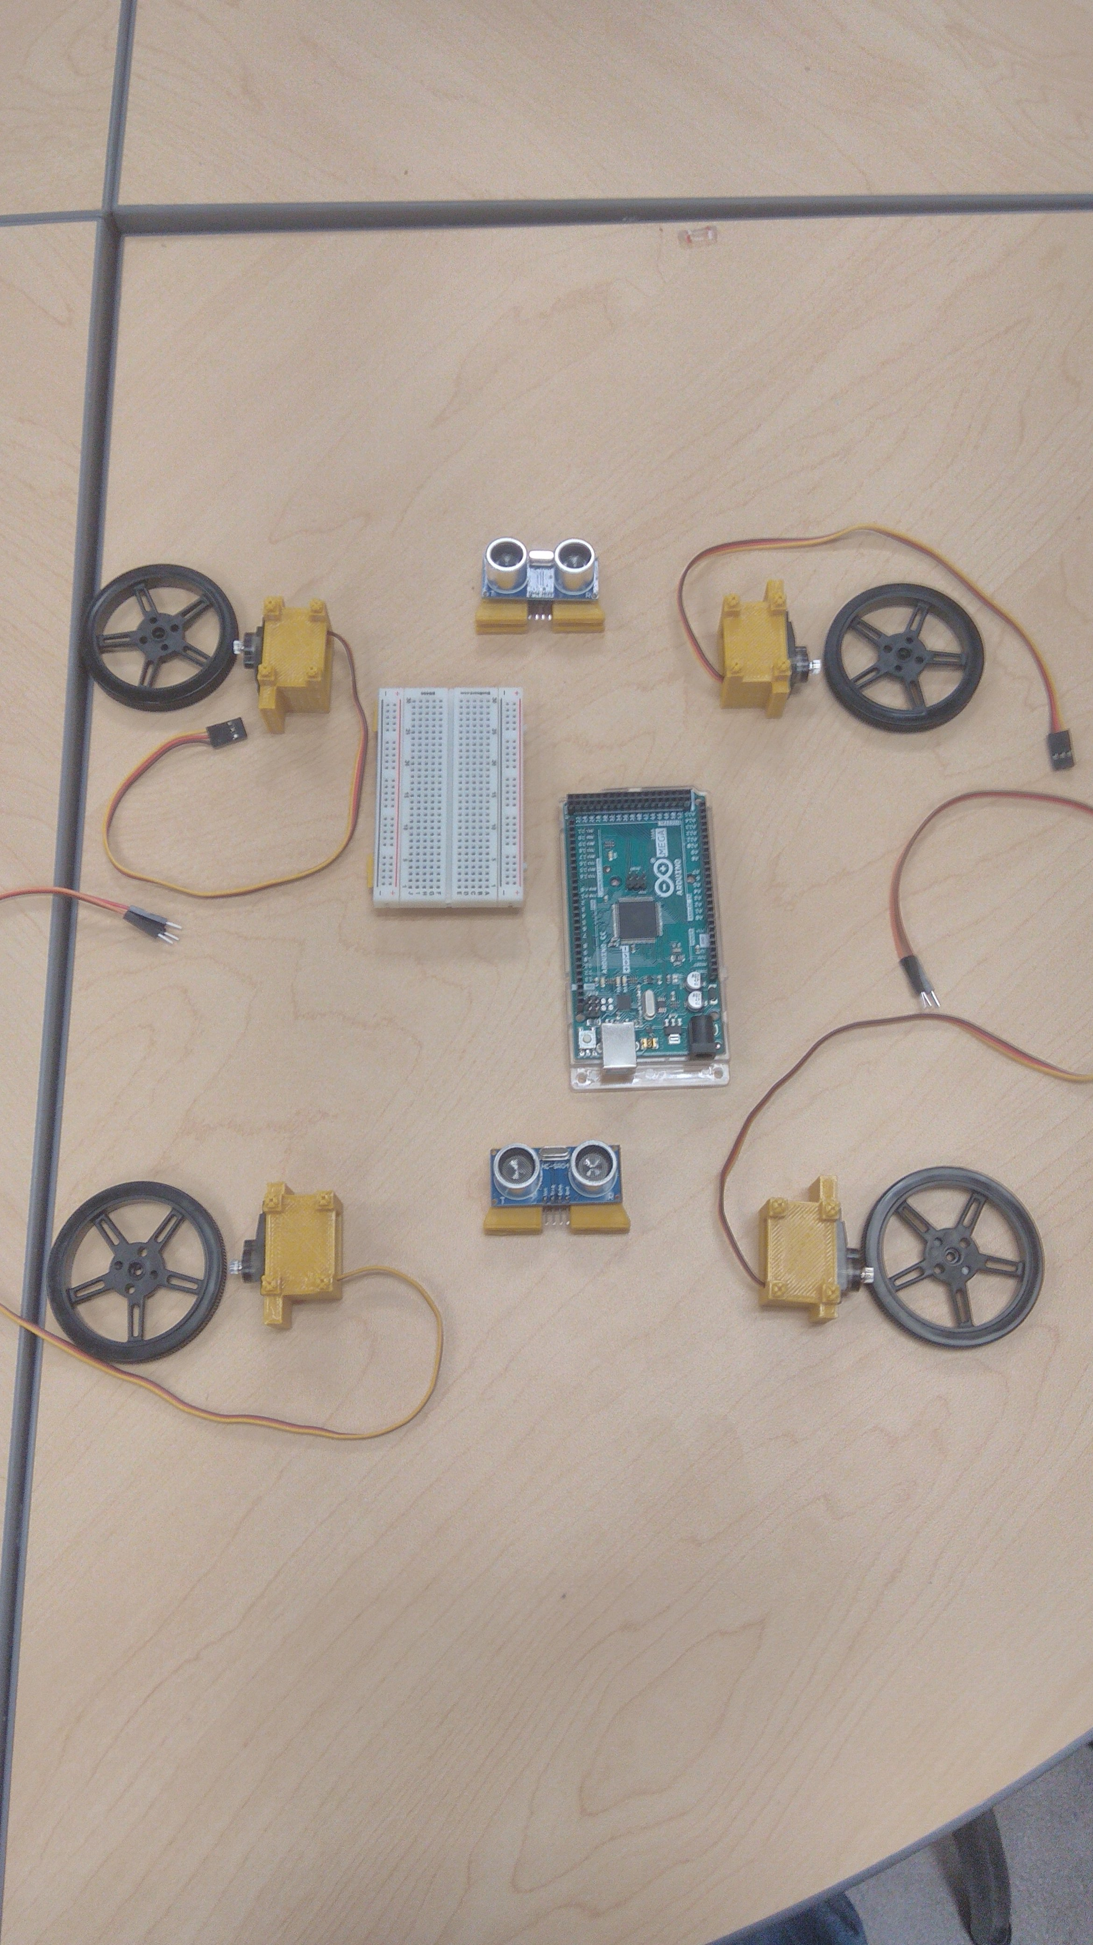
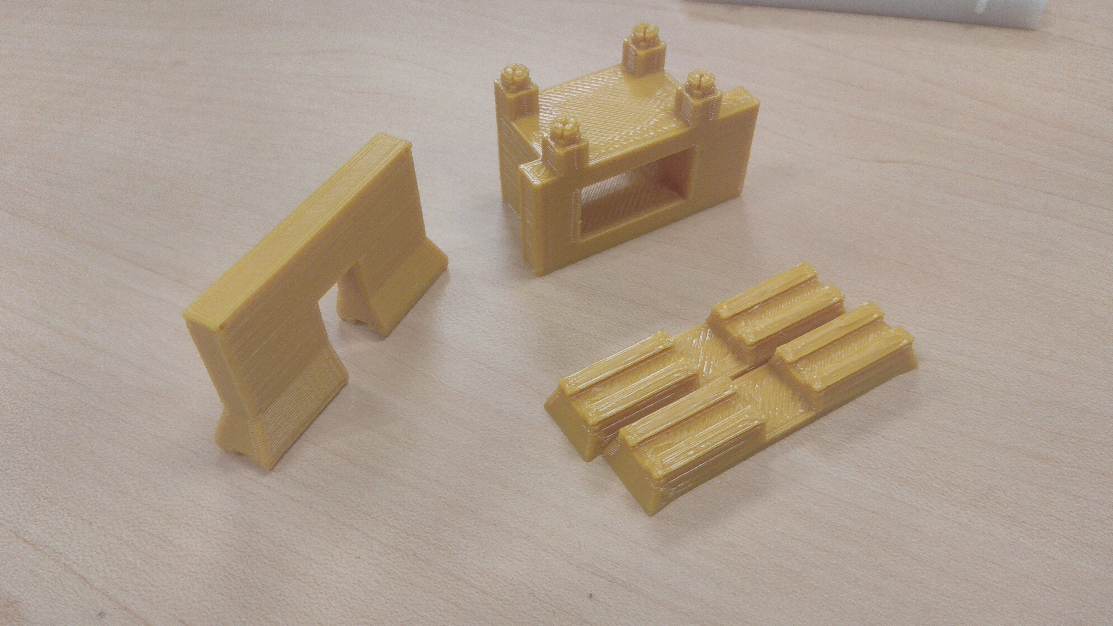
What we achieved
We have a new Co-chair, and Project Manager.
We have the base for a robot that can potentially enter multiple different competitions, and will stay with the team after we graduate
We have a source code that can be used for many years
We have a lot of spare parts and training for new members to use said parts for generations to come

Slide 9
The future of the Robotics club
We hope that intersession will allow us to have a fully assembled and moving robot by Spring’s beginning or by week 8 at the latest
We will scope out local robotics competitions and set goals for the modular robot’s design
We will have more meeting times and a more prudent schedule to meet with our members.

